Slide 1

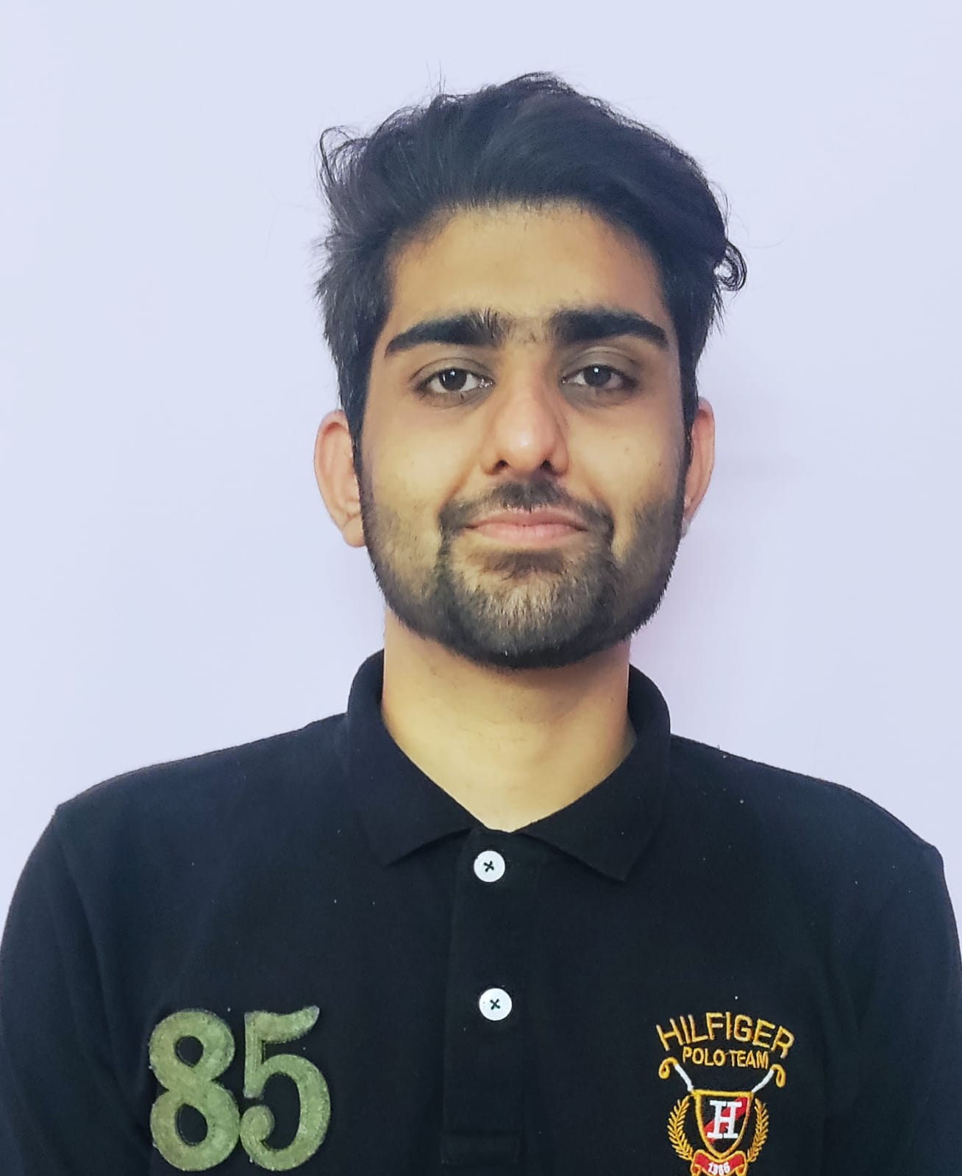


LUV
Education and certificates
Bachelor of Engineering in
Electronics & Communication Engineering: 2018-2022
Analyst/Software Engineer
Base Location: Bangalore
Email ID:
LUV.LUV@CAPGEMINI.COM
Skills
Mobile No: +91 7023418336
Grade: A4
EMP ID-46290498
Java | Basics, OOPS, Exception Handling, Collections & Generics, Java 8 Features
Spring Framework | Spring MVC. Spring JDBC, Spring Boot
React | Components, Hooks, Virtual DOM, Routing, Forms, React Redux & Validation
Database handling | MongoDB
UI Technology | HTML 5, CSS, JavaScript
Tools | Git ,GitHub, Postman, Eclipse, Visual Studio code
Add On Skills | Communication , Team management , Problem solving, Adaptability
Strengths
Full Stack Developer
Good Knowledge of Java programming.
Achievement
DEALS AND COUPONS:
Case study of Deals and Coupons along with Spring Boot, HTML5, CSS and React used as User Interface.
•Good Knowledge of Spring Framework
•Good in developing web pages using HTML, CSS.
•Currently learning on iTransform: Full Stack With React, Spring Boot MS & MongoDB and AWS
Full Stack developer with React and Full Stack Java Developer
Four layered architecture which includes a Presentation Layer, Business Layer, Persistence Layer and Database Layer. Exception Layer handled the exceptions.
Hands on experience in developing web pages
using HTML5, CSS3, REACT. Good understanding of Document Object Model (DOM) and DOM Functions.
Proficient in creating Single page Web Application in
REACT with routing.
Check out my work on GitHub
Presentation Title | Author | Date © Capgemini 2017. All rights reserved | 1

